Slide 1
Deep Reinforcement Learning
Notes:
SVG
DPG
DDPG
Similar to GAN
DQN
4.5 Double DQN (Tensorflow)
4.6 Prioritized Experience Replay (DQN) (Tensorflow) say this?
4.7 Dueling DQN (Tensorflow)

Slide 2
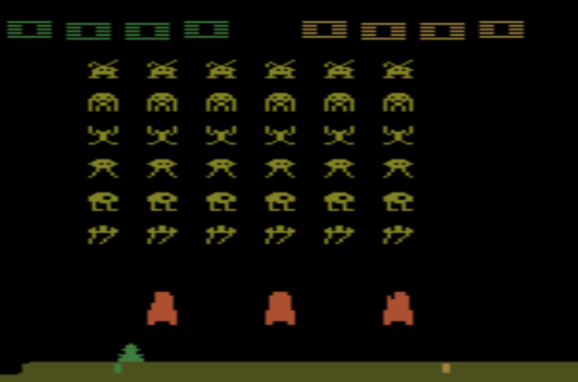
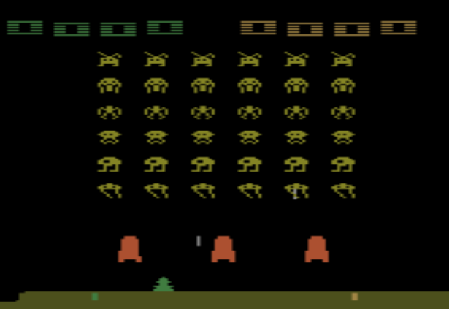
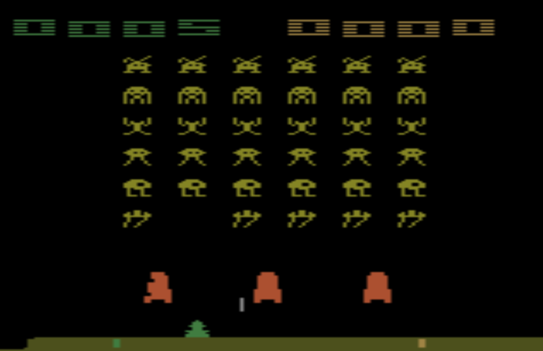

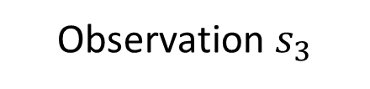
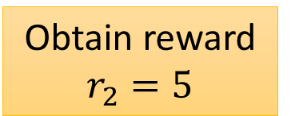
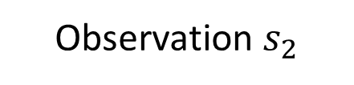

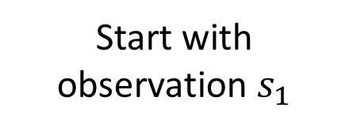
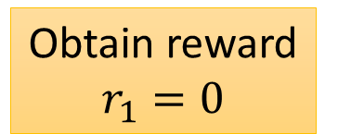

Example: Playing Video Game
Start with observation $s_{1}$
Observation $s_{2}$
Observation $s_{3}$
Obtain reward $r_{1}=0$
Obtain reward $r_{2}=5$
Action $a_{1}$: “right”
Action $a_{2}$: “fire”
(kill an alien)
Usually there is some randomness in the environment

Slide 3
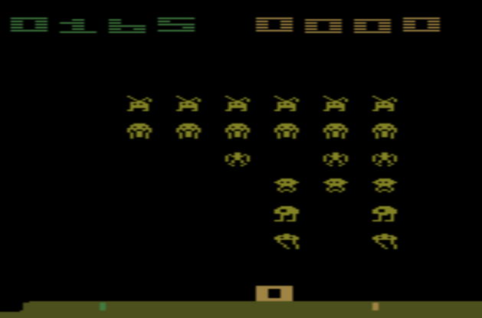
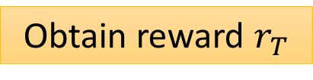
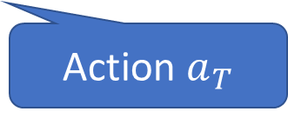
Example: Playing Video Game
Start with observation $s_{1}$
Observation $s_{2}$
Observation $s_{3}$
This is an episode.
After many turns
Game Over
(spaceship destroyed)
Learn to maximize the expected cumulative reward per episode
Obtain reward $r_{T}$
Action $a_{T}$

Slide 4
Approaches
Model-free Approach
Policy-based
Value-based
Learning an Actor
Actor + Critic
Learning a Critic
Model-based Approach
Notes:
Alpha Go: policy-based + value-based + model-based

Slide 5


On-policy v.s. Off-policy
On-policy: The agent learned and the agent interacting with the environment is the same.
Off-policy: The agent learned and the agent interacting with the environment is different.
阿光下棋
佐為下棋、阿光在旁邊看

Slide 6
Asynchronous Advantage Actor-Critic (A3C)
Volodymyr Mnih, Adrià Puigdomènech Badia, Mehdi Mirza, Alex Graves, Timothy P. Lillicrap, Tim Harley, David Silver, Koray Kavukcuoglu, “Asynchronous Methods for Deep Reinforcement Learning”, ICML, 2016

Slide 7

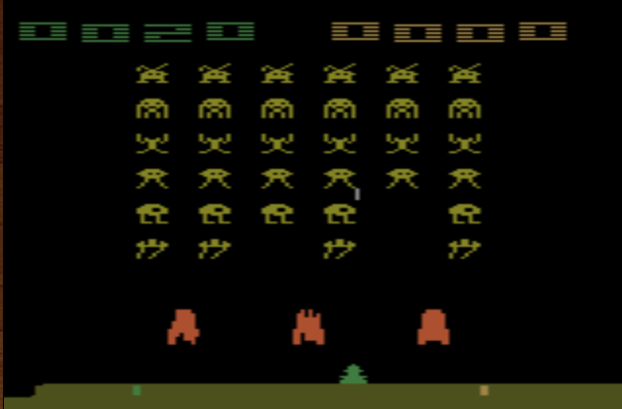
Actor is a Neural network
Input of neural network: the observation of machine represented as a vector or a matrix
Output neural network : each action corresponds to a neuron in output layer
NN as actor
left
0.7
Probability of taking the action
…
right
0.2
…
fire
0.1
pixels
Sample an action based on the probability or argmax
Actor can also have continuous action.
Notes:
Taking the action with the highest score

Slide 8
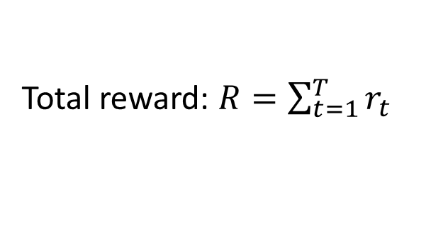
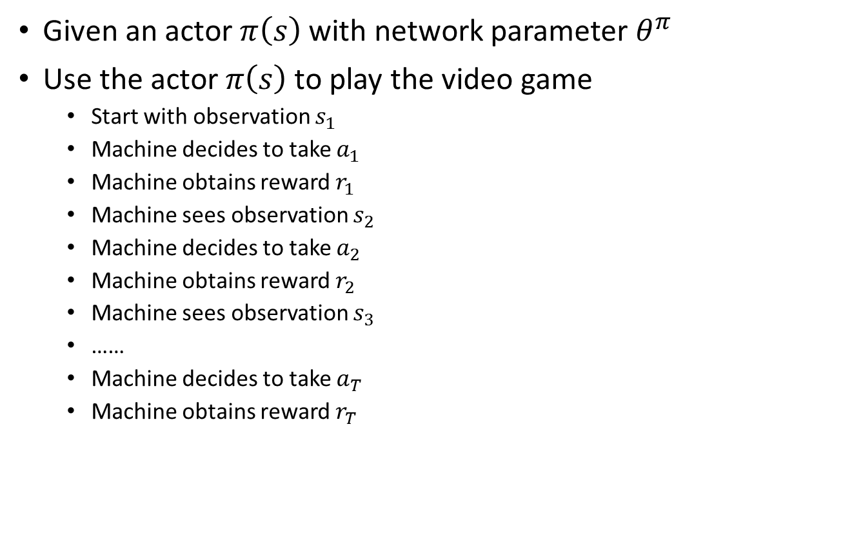
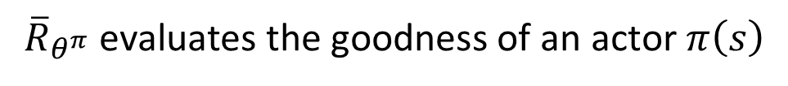
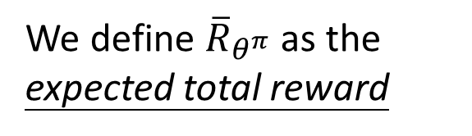
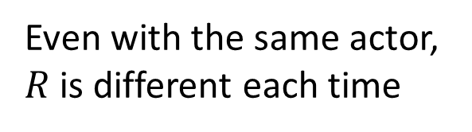
Actor – Goodness of an Actor
Given an actor $π\left(s\right)$ with network parameter $θ^{π}$
Use the actor $π\left(s\right)$ to play the video game
Start with observation $s_{1}$
Machine decides to take $a_{1}$
Machine obtains reward $r_{1}$
Machine sees observation $s_{2}$
Machine decides to take $a_{2}$
Machine obtains reward $r_{2}$
Machine sees observation $s_{3}$
……
Machine decides to take $a_{T}$
Machine obtains reward $r_{T}$
Total reward: $R=\sum_{t=1}^{T}{r_{t}}$
Even with the same actor, $R$ is different each time
Randomness in the actor and the game
We define ${\overline{R}}_{θ^{π}}$ as the expected total reward
END
${\overline{R}}_{θ^{π}}$evaluates the goodness of an actor $π\left(s\right)$

Slide 9
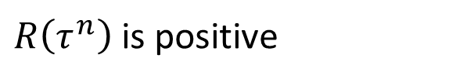
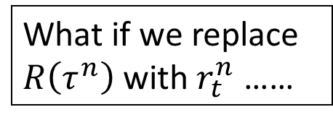
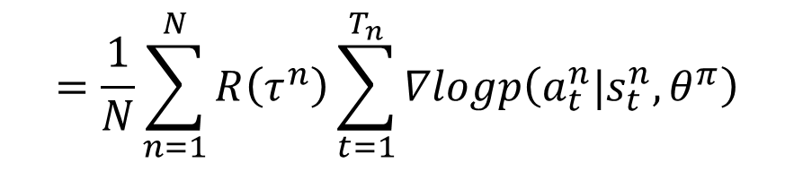
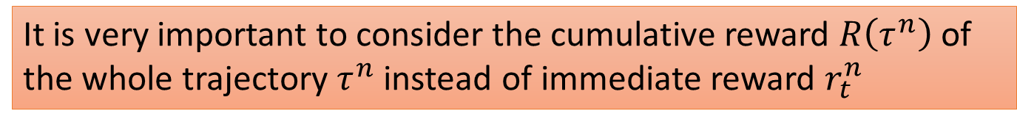
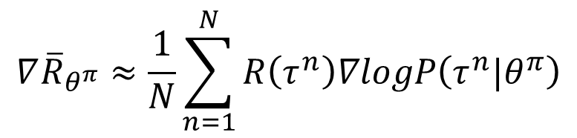
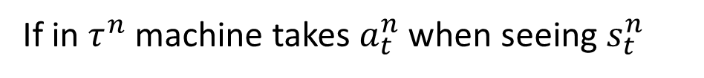
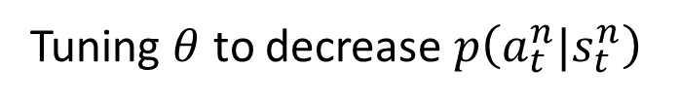
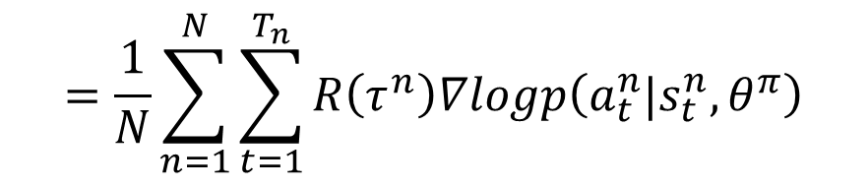
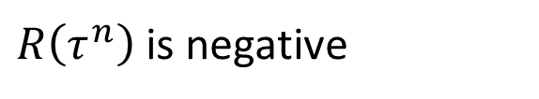
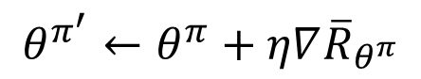
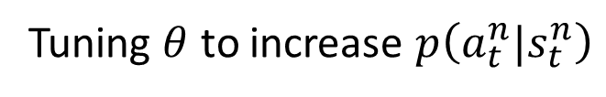
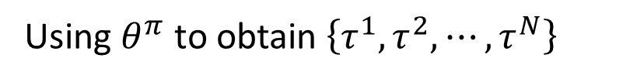
Actor – Policy Gradient
$$θ^{π^{′}}←θ^{π}+η∇{\overline{R}}_{θ^{π}}$$
Using $θ^{π}$ to obtain $\left\{τ^{1},τ^{2},⋯,τ^{N}\right\}$
$$∇{\overline{R}}_{θ^{π}}≈\frac{1}{N}\sum_{n=1}^{N}{R\left(τ^{n}\right)∇logP\left(τ^{n}|θ^{π}\right)}$$
$$=\frac{1}{N}\sum_{n=1}^{N}{R\left(τ^{n}\right)\sum_{t=1}^{T_{n}}{∇logp\left(a_{t}^{n}|s_{t}^{n},θ^{π}\right)}}$$
$$=\frac{1}{N}\sum_{n=1}^{N}{\sum_{t=1}^{T_{n}}{R\left(τ^{n}\right)∇logp\left(a_{t}^{n}|s_{t}^{n},θ^{π}\right)}}$$
What if we replace $R\left(τ^{n}\right)$ with $r_{t}^{n}$ ……
If in $τ^{n}$ machine takes $a_{t}^{n}$ when seeing $s_{t}^{n}$
$R\left(τ^{n}\right)$ is positive
Tuning $θ$ to increase $p\left(a_{t}^{n}|s_{t}^{n}\right)$
$R\left(τ^{n}\right)$ is negative
Tuning $θ$ to decrease $p\left(a_{t}^{n}|s_{t}^{n}\right)$
It is very important to consider the cumulative reward $R\left(τ^{n}\right)$ of the whole trajectory $τ^{n}$ instead of immediate reward $r_{t}^{n}$

Slide 10
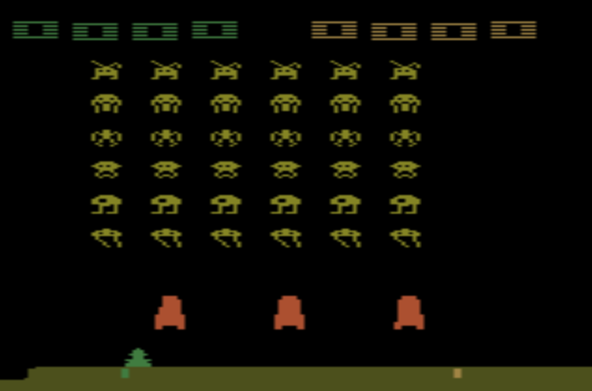
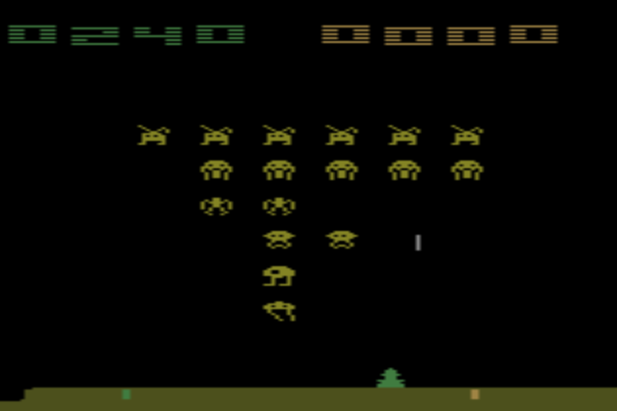
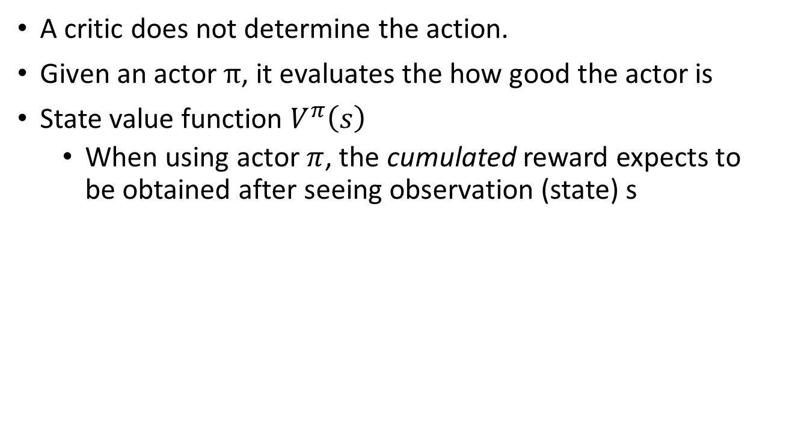
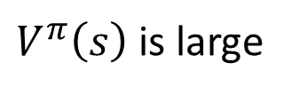
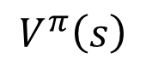
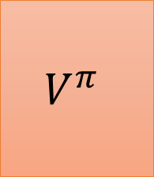
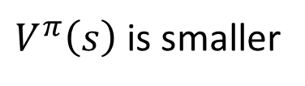
Critic
A critic does not determine the action.
Given an actor $π$, it evaluates the how good the actor is
State value function $V^{π}\left(s\right)$
When using actor $π$, the cumulated reward expects to be obtained after seeing observation (state) s
$$V^{π}$$
$$V^{π}\left(s\right)$$
s
scalar
$V^{π}\left(s\right)$ is large
$V^{π}\left(s\right)$ is smaller
Notes:
(Lots of aliens to be killed, and the shields still exist)

Slide 11
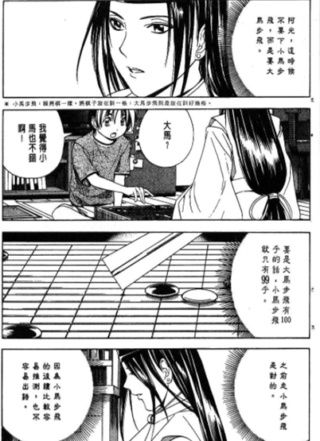
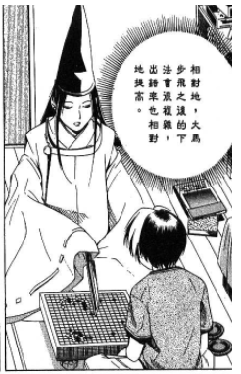
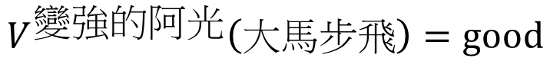
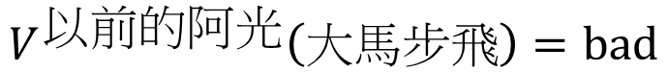
Critic
$$V^{以前的阿光}\left(大馬步飛\right)=bad$$
$$V^{變強的阿光}\left(大馬步飛\right)=good$$
Notes:
http://combiboilersleeds.com/picaso/critics/critics-4.html

Slide 12
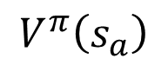
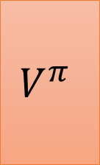
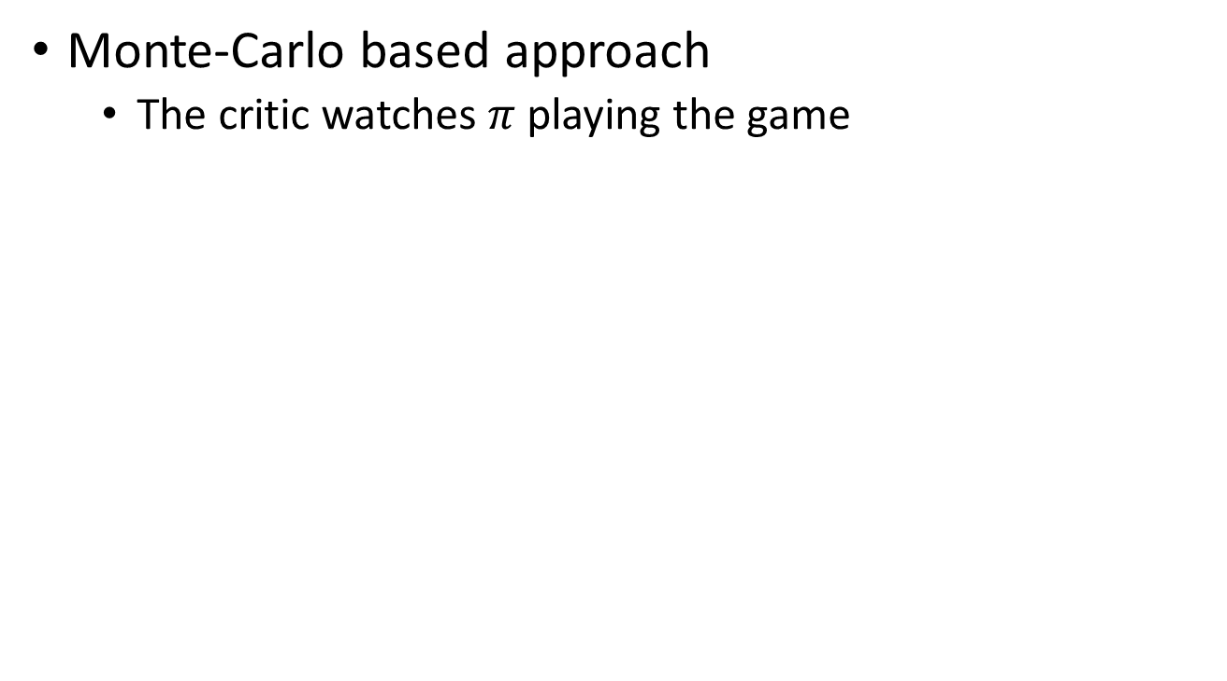
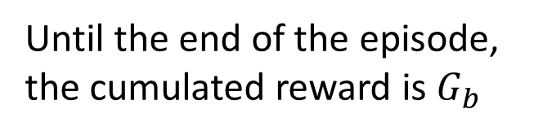
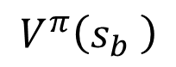
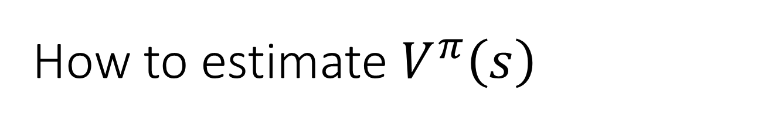

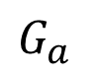
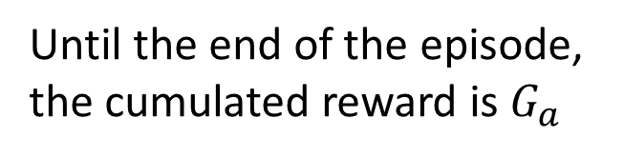
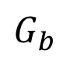
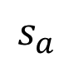



How to estimate $V^{π}\left(s\right)$
Monte-Carlo based approach
The critic watches $π$ playing the game
After seeing $s_{a}$,
$$V^{π}$$
Until the end of the episode, the cumulated reward is $G_{a}$
$$s_{a}$$
$$V^{π}\left(s_{a}\right)$$
$G_{a}$
After seeing $s_{b}$,
$$V^{π}$$
Until the end of the episode, the cumulated reward is $G_{b}$
$$s_{b}$$
$$V^{π}\left(s_{b} \right)$$
$G_{b}$

Slide 13










How to estimate $V^{π}\left(s\right)$
Temporal-difference approach
$$⋯s_{t},a_{t},r_{t},s_{t+1}⋯$$
$$V^{π}$$
$$V^{π}\left(s_{a}\right)+r_{t}=V^{π}\left(s_{b} \right)$$
$$s_{t}$$
$$V^{π}\left(s_{t}\right)$$
-
$$V^{π}\left(s_{t}\right)−V^{π}\left(s_{t+1}\right)$$
$$r_{t}$$
$$V^{π}$$
$$s_{t+1}$$
$$V^{π}\left(s_{t+1}\right)$$
Some applications have very long episodes, so that delaying all learning until an episode's end is too slow.
Notes:
The next most obvious advantage of TD methods over Monte Carlo methods is
that they are naturally implemented in an on-line, fully incremental fashion. With
Monte Carlo methods one must wait until the end of an episode, because only then
is the return known, whereas with TD methods one need wait only one time step.
Surprisingly often this turns out to be a critical consideration Other applications are continuing tasks and have no episodes at all.

Slide 14










MC v.s. TD
$$V^{π}$$
Larger variance
$$s_{a}$$
$$V^{π}\left(s_{a}\right)$$
$G_{a}$
unbiased
$$V^{π}$$
$$V^{π}$$
$$s_{t}$$
$$V^{π}\left(s_{t}\right)$$
$$r+$$
$$V^{π}\left(s_{t+1}\right)$$
$$s_{t+1}$$
Smaller variance
May be biased

Slide 15





MC v.s. TD
[Sutton, v2, Example 6.4]
The critic has the following 8 episodes
$s_{a},r=0,s_{b},r=0$, END
$s_{b},r=1$, END
$s_{b},r=1$, END
$s_{b},r=1$, END
$s_{b},r=1$, END
$s_{b},r=1$, END
$s_{b},r=1$, END
$s_{b},r=0$, END
$$V^{π}\left(s_{b}\right)=3/4$$
$$V^{π}\left(s_{a}\right)=?$$
0?
3/4?
Monte-Carlo:
$$V^{π}\left(s_{a}\right)=0$$
Temporal-difference:
$$V^{π}\left(s_{a}\right)+r=V^{π}\left(s_{b}\right)$$
3/4
0
3/4
(The actions are ignored here.)

Slide 16

Actor-Critic
$π$ interacts with the environment
𝜋 interacts with the environment
Learning $V^{π}\left(s\right)$
Learning 𝑉^𝜋 (𝑠)
Update actor from $π→π’$ based on $V^{π}\left(s\right)$
Update actor from 𝜋→𝜋’ based on 𝑉^𝜋 (𝑠)
$$π=π^{′}$$
TD or MC
?

Slide 17









Advantage Actor-Critic
$$θ^{π^{′}}←θ^{π}+η∇{\overline{R}}_{θ^{π}}$$
$$∇{\overline{R}}_{θ^{π}}$$
$$=\frac{1}{N}\sum_{n=1}^{N}{\sum_{t=1}^{T_{n}}{R\left(τ^{n}\right)∇logp\left(a_{t}^{n}|s_{t}^{n},θ^{π}\right)}}$$
Evaluated by critic
Baseline is added
Advantage Function:
$$r_{t}^{n}−\left(V^{π}\left(s_{t}^{n}\right)−V^{π}\left(s_{t+1}^{n}\right)\right)$$
The reward $r_{t}^{n}$ we truly obtain when taking action $a_{t}^{n}$
Expected reward $r_{t}^{n}$ we obtain if we use actor $π$
Positive advantage function
Increasing the prob. of action $a_{t}^{n}$
Negative advantage function
decreasing the prob. of action $a_{t}^{n}$
Notes:
Using Q,

Slide 18



Advantage Actor-Critic
Tips
The parameters of actor $π\left(s\right)$ and critic $V^{π}\left(s\right)$ can be shared
Use output entropy as regularization for $π\left(s\right)$
Larger entropy is preferred $→$ exploration
Network
left
Network
right
$$s$$
fire
Network
$$V^{π}\left(s\right)$$

Slide 19








Asynchronous
Source of image: https://medium.com/emergent-future/simple-reinforcement-learning-with-tensorflow-part-8-asynchronous-actor-critic-agents-a3c-c88f72a5e9f2#.68x6na7o9
$$θ^{1}$$
$$+η∆θ$$
$$θ^{2}$$
1. Copy global parameters
(other workers also update models)
2. Sampling some data
$$∆θ$$
3. Compute gradients
$$θ^{1}$$
4. Update global models
$$θ^{1}$$
$$∆θ$$

Slide 20
Pathwise Derivative Policy Gradient
David Silver, Guy Lever, Nicolas Heess, Thomas Degris, Daan Wierstra, Martin Riedmiller, “Deterministic Policy Gradient Algorithms”, ICML, 2014
Timothy P. Lillicrap, Jonathan J. Hunt, Alexander Pritzel, Nicolas Heess,
Tom Erez, Yuval Tassa, David Silver, Daan Wierstra, “CONTINUOUS CONTROL WITH DEEP REINFORCEMENT LEARNING”, ICLR, 2016

Slide 21


Actor
Critic
Pathwise derivative policy gradient
Original Actor-critic
http://www.cartomad.com/comic/109000081104011.html

Slide 22







Another Critic
State-action value function $Q^{π}\left(s,a\right)$
When using actor $π$, the cumulated reward expects to be obtained after seeing observation s and taking a
$$Q^{π}$$
$$Q^{π}$$
$$Q^{π}\left(s,a=left\right)$$
s
$$Q^{π}\left(s,a\right)$$
s
$$Q^{π}\left(s,a=right\right)$$
scalar
a
$$Q^{π}\left(s,a=fire\right)$$
for discrete action only

Slide 23






Another Way to use Critic
$$Q^{π}\left(s,a\right)$$
Original
Actor-critic
$$a_{1}$$
$$a_{2}$$
decrease
increase
Q-Learning
We know the parameters of Q function
$$Q^{π}\left(s,a\right)$$
From Q function we know that taking a’ at state s is better than a
$$a′$$
$$a$$

Slide 24
Q-Learning
$π$ interacts with the environment
𝜋 interacts with the environment
Learning $Q^{π}\left(s,a\right)$
Learning 𝑄^𝜋 (𝑠,𝑎)
Find a new actor $π^{′}$ “better” than $π$
Find a new actor 𝜋^′ “better” than 𝜋
$$π=π^{′}$$
TD or MC
?
Estimate Q instead of V
Notes:
Add some noise

Slide 25



Q-Learning
Given $Q^{π}\left(s,a\right)$, find a new actor $π^{′}$ “better” than $π$
“Better”: $V^{π^{′}}\left(s\right)≥V^{π}\left(s\right)$, for all state s
$$π^{′}\left(s\right)=arg\max_{a}{Q^{π}\left(s,a\right)}$$
$π^{′}$ does not have extra parameters. It depends on Q
Not suitable for continuous action a (solve it later)

Slide 26








Q-Learning
$$π^{′}\left(s\right)=arg\max_{a}{Q^{π}\left(s,a\right)}$$
$V^{π^{′}}\left(s\right)≥V^{π}\left(s\right)$, for all state s
$$V^{π}\left(s\right)=Q^{π}\left(s,π\left(s\right)\right)$$
$$≤\max_{a}{Q^{π}\left(s,a\right)}$$
$$=Q^{π}\left(s,π^{′}\left(s\right)\right)$$
$$V^{π}\left(s\right)$$
$$≤Q^{π}\left(s,π^{′}\left(s\right)\right)$$
$$=E_{π^{′}}[r_{t+1}+V^{π}\left(s_{t+1}\right)|s_{t}=s]$$
$$≤E_{π^{′}}[r_{t+1}+Q^{π}\left(s_{t+1},π^{′}\left(s_{t+1}\right)\right)|s_{t}=s]$$
$$=E_{π^{′}}[r_{t+1}+r_{t+2}+V^{π}\left(s_{t+2} \right)|s_{t}=s]$$
$$≤E_{π^{′}}[r_{t+1}+r_{t+2}+Q^{π}\left(s_{t+2},π^{′}\left(s_{t+2}\right)\right)|s_{t}=s]$$
$……$ $≤$ $V^{π^{′}}\left(s\right)$

Slide 27













Estimate $Q^{π}\left(s,a\right)$ by TD
$$⋯s_{t},a_{t},r_{t},s_{t+1}⋯$$
$$Q^{π}\left(s_{t},a_{t}\right)$$
$$Q^{π}\left(s_{t+1},π\left(s_{t+1}\right)\right)$$
$$Q^{π}$$
$$s_{t}$$
$$Q^{π}\left(s_{t},a_{t}\right)$$
$$a_{t}$$
$$Q^{π}$$
$$s_{t+1}$$
$$r_{t}+$$
$$Q^{π}\left(s_{t+1},π\left(s_{t+1}\right)\right)$$
$$π\left(s_{t+1}\right)$$
freeze
freeze

Slide 28




Double DQN
Q value is usually over estimate
$$Q\left(s_{t},a_{t}\right)$$
$$r_{t}+\max_{a}{Q\left(s_{t+1},a\right)}$$
Tend to select the action that is over-estimated
$$Q\left(s_{t+1},a\right)$$

Slide 29


Double DQN
Q value is usually over estimate
Double DQN: two functions Q and Q’
$$Q\left(s_{t},a_{t}\right)$$
$$r_{t}+\max_{a}{Q\left(s_{t+1},a\right)}$$
$$Q\left(s_{t},a_{t}\right)$$
$$r_{t}+Q′\left(s_{t+1},arg\max_{a}{Q\left(s_{t+1},a\right)}\right)$$
If Q over-estimate a, so it is selected. Q’ would give it proper value.
How about Q’ overestimate? The action will not select by Q.
Hado V. Hasselt, “Double Q-learning”, NIPS 2010
Hado van Hasselt, Arthur Guez, David Silver, “Deep Reinforcement Learning with Double Q-learning”, AAAI 2016

Slide 30

Dueling DQN
Ziyu Wang, Tom Schaul, Matteo Hessel, Hado van Hasselt, Marc Lanctot, Nando de Freitas, “Dueling Network Architectures for Deep Reinforcement Learning”, arXiv preprint, 2015
Action
a
Q(s,a)
State
s
V(s)
Action
a
State
s
Q(s,a)
A(s,a)=Q(s,a) – V(s)
Notes:
https://arxiv.org/pdf/1511.06581.pdf
For example: imagine sitting outside in a park watching the sunset. It is beautiful, and highly rewarding to be sitting there. No action needs to be taken, and it doesn’t really make sense to think of the value of sitting there as being conditioned on anything beyond the environmental state you are in. We can achieve more robust estimates of state value by decoupling it from the necessity of being attached to specific actions.

Slide 31

Dueling DQN - Visualization
(from the link in the original paper)

Slide 32

Dueling DQN - Visualization
(from the link in the original paper)

Slide 33











Pathwise Derivative Policy Gradient
$$=arg\max_{a}{Q^{π}\left(s,a\right)}$$
$$π^{′}\left(s\right)$$
a is the output of an actor
Gradient ascent:
Fixed
$$θ^{π^{′}}←θ^{π}+η∇_{θ^{π}}Q^{π}\left(s,a\right)$$
$$Q^{π}$$
$$s$$
Update $π→π^{′}$
$$Q^{π}\left(s,a\right)$$
$$s$$
Actor
$$a$$
=
$$a$$
$$π$$
This is a large network

Slide 34










$π$ interacts with the environment
𝜋 interacts with the environment
Learning $Q^{π}\left(s,a\right)$
Learning 𝑄^𝜋 (𝑠,𝑎)
Find a new actor $π^{′}$ “better” than $π$
Find a new actor 𝜋^′ “better” than 𝜋
Replay
Buffer
Add noise
$$π=π^{′}$$
TD or MC
$$θ^{π^{′}}←θ^{π}+η∇_{θ^{π}}Q^{π}\left(s,a\right)$$
$$Q^{π}$$
$$s$$
Update $π→π^{′}$
$$Q^{π}\left(s,a\right)$$
$$s$$
Actor
$$a$$
$$π$$
=
$$a$$
Notes:
Add some noise

Slide 35



DDPG Algorithm
Initialize critic network $θ^{Q}$ and actor network $θ^{π}$
Initialize target critic network $θ^{Q^{′}}=θ^{Q}$ and target actor network $θ^{π^{′}}=θ^{π}$
Initialize replay buffer R
In each iteration
Use $π\left(s\right)+noise$ to interact with the environment, collect a set of $\left\{s_{t},a_{t},r_{t},s_{t+1}\right\}$, put them in R
Sample N examples $\left\{s_{n},a_{n},r_{n},s_{n+1}\right\}$ from R
Update critic $Q$ to minimize: $L=\sum_{n}{{\left({\hat{y}}_{n}−Q\left(s_{n},a_{n}\right)\right)}^{2}}$
${\hat{y}}_{n}=r_{n}+Q^{′}\left(s_{n+1},π^{′}\left(s_{n+1}\right)\right)$
Update actor $π$ to maximize: $J=\sum_{n}{Q\left(s_{n},π\left(s_{n}\right)\right)}$
Update target networks:
Using target networks
$$θ^{π^{′}}←mθ^{π}+\left(1−m\right)θ^{π^{′}}$$
The target networks update slower
$$θ^{Q^{′}}←mθ^{Q}+\left(1−m\right)θ^{Q^{′}}$$

Slide 36
Connection with GAN

Slide 37









GAN as Actor-critic
Prior
Generator
Actor
0
0
0
0
Action: generate an object
1
1
1
1
傳說中的 Action
image
Discri-minator
Critic
1/0
realistic or not

Slide 38









Actor-critic as GAN
Generator sometimes generates good stuff
Actor
Get some reward
……
……
Gene
rator
……
……
$$s_{1}$$
$$s_{t}$$
$$s_{T}$$
$$a_{1}$$
$$a_{t}$$
$$a_{T}$$
Critic
$$a$$
Discriminator
$$Q\left(s,a\right)$$
$$s$$
Estimated reward

Slide 39
David Pfau, Oriol Vinyals, “Connecting Generative Adversarial Networks and Actor-Critic Methods”, arXiv preprint, 2016

